Slide 1




A Spitzer Mid-Infrared Survey of Brightest Cluster Galaxies
Presented by: Andrew Fiedler
Project Mentor: Dr. Eiichi Egami
Special Thanks To: Dr. Linhua Jiang
April 17th, 2010

Slide 2
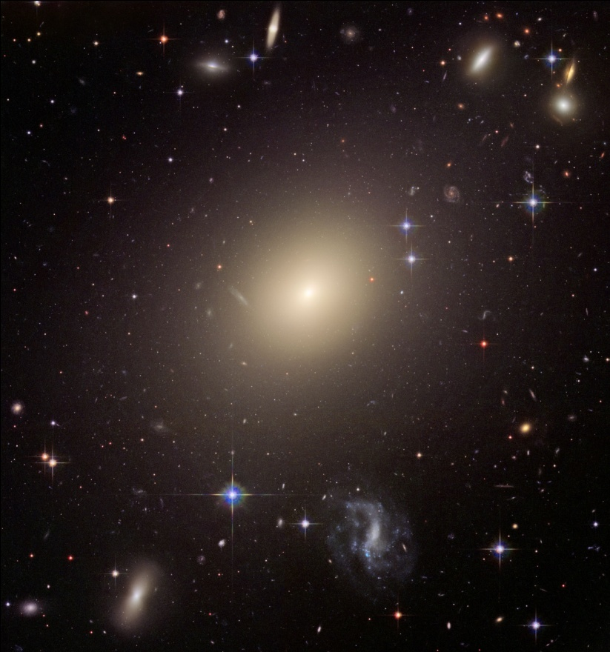
Brightest Cluster Galaxies (BCGs)
What are they?
The centrally located galaxy in a galaxy cluster
Most luminous of their respective cluster
Generally giant ellipticals
Hence, old and minimally active
Abell S0740 Galaxy Cluster
Source: NASA

Slide 3
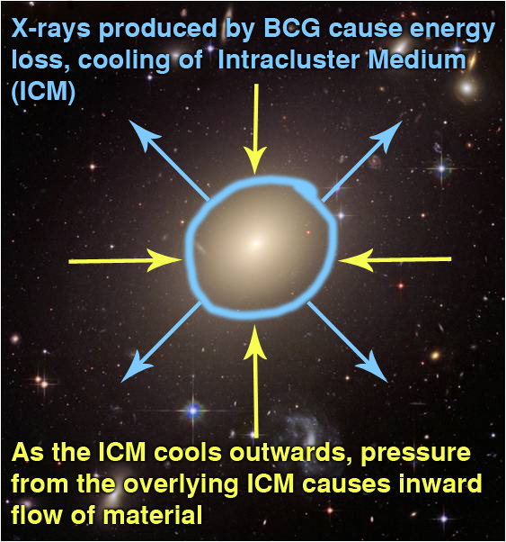
Brightest Cluster Galaxies (BCGs)
Why study them?
What Cluster Cooling Flows Entail
Some BCGs are theorized to experience cluster cooling flows
Possibly analogous to galaxy formation in the early universe
Studying them could provide integral insight into galaxy formation
Abell S0740 Galaxy Cluster
Source: NASA

Slide 4
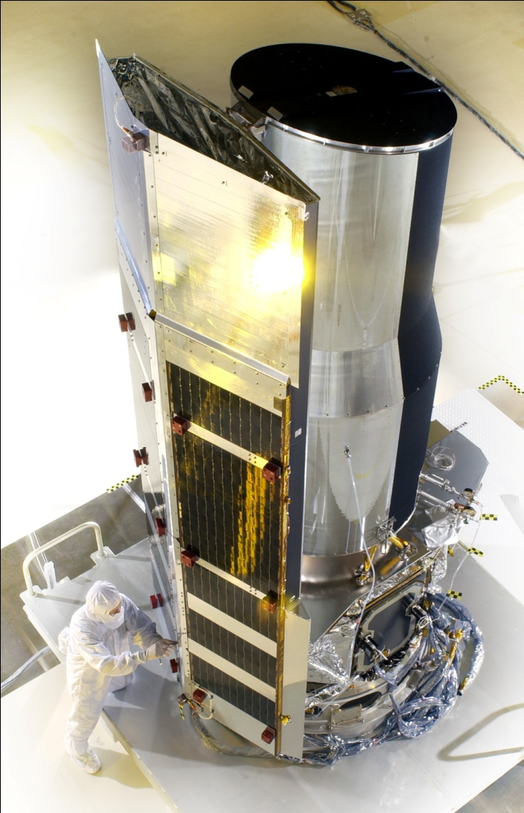
Project Outline
Over a hundred BCGs were recently surveyed by the Multiband Imaging Photometer for Spitzer (MIPS) aboard the Spitzer Space Telescope
Year and a half of observations, a massive amount of data overall
Goal: To analyze each BCG data set and pinpoint possible candidates for cluster cooling flows
Spitzer Space Telescope
Source: NASA

Slide 5
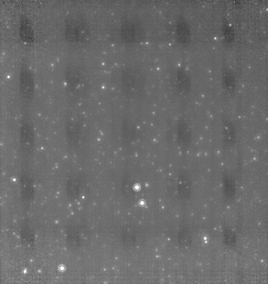
Methods / Analysis
Lots of data to analyze
Most Important Step: Developing a dynamic program that could handle any data set
Its construction allowed detector variations, optical distortions, and other processes to be handled automatically
Before and After Processing

Slide 6
Overall Results
With support from spectroscopy, four distinct types of BCGs were found to exist
Type 1 - BCGs with active galactic nuclei (AGN)
Type 2 - BCGs with star formation
Type 3 - BCGs with hot dust from older stars
Type 4 - BCGs without mid-infrared emission
Type 1 and 2 are possible candidates for cluster cooling flows, thus 20 candidates were found in all

Slide 7
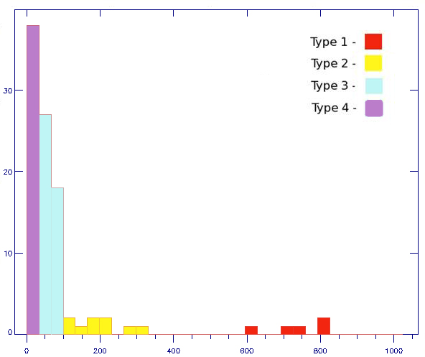
Overall Results
Histogram of Surveyed BCG Intensities at 24 Microns
Density of
BCG Sources
at Each
Intensity
Flux (in micro-Janskys)

Slide 8
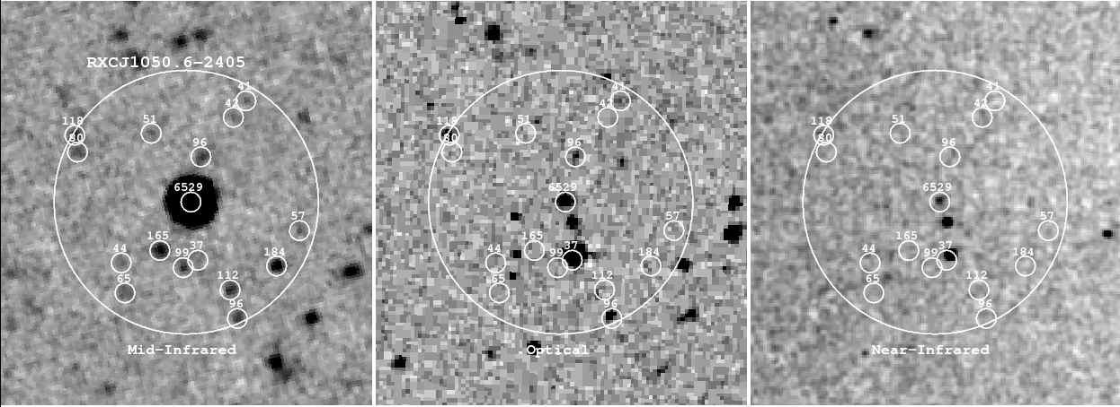
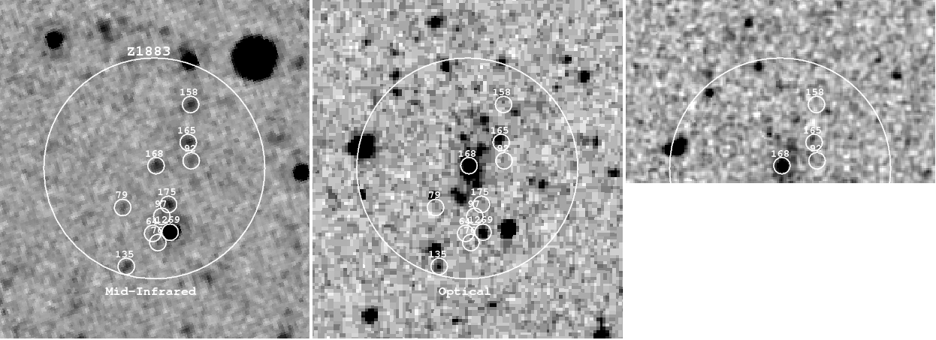
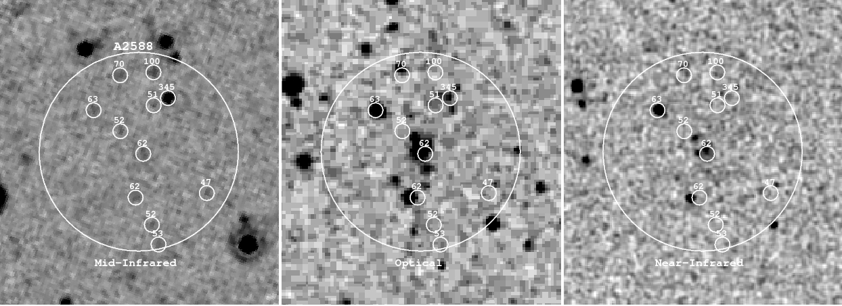
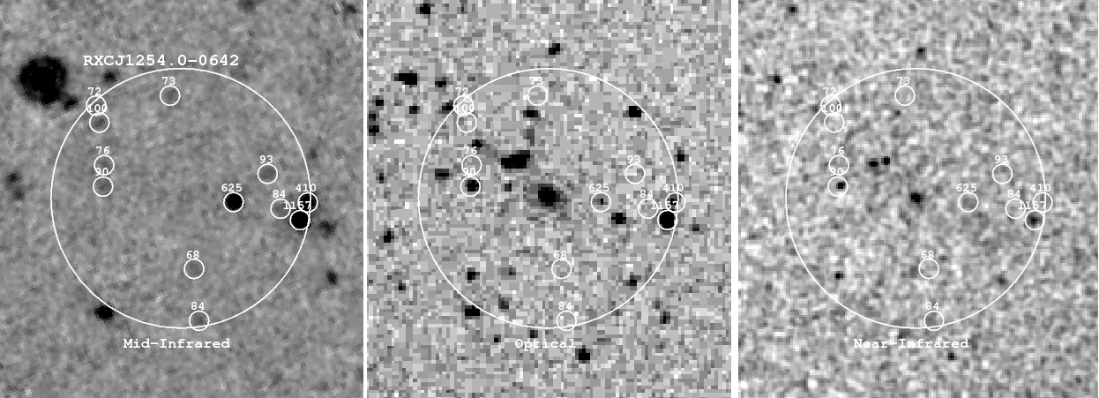
Type 1 – AGN
Type 2 – Star Formation
Type 3 – Hot Dust
Type 4 – No Emission
Mid-Infrared Optical Near-Infrared
Mid-Infrared Optical Near-Infrared
Mid-Infrared Optical Near-Infrared
Mid-Infrared Optical Near-Infrared
Note: Each circle represents a different source detection.
The numbers above each represent their intensity.

Slide 9
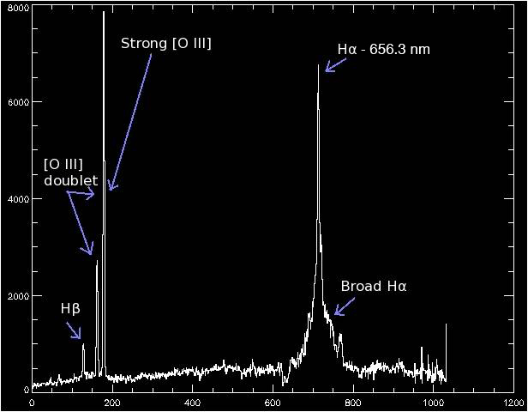
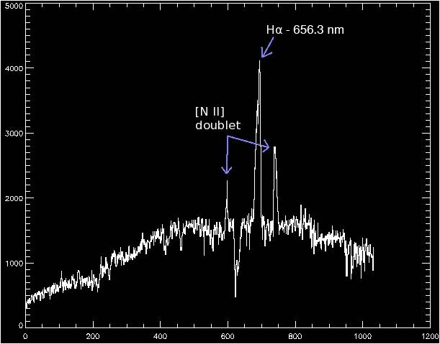
Current Endeavors
Spectra Taken While at the MMT Observatory
RXCJ0150.6-2405 – AGN
Preliminary Spectroscopy
Z1883 – Star Formation
Preliminary Spectroscopy

Slide 10
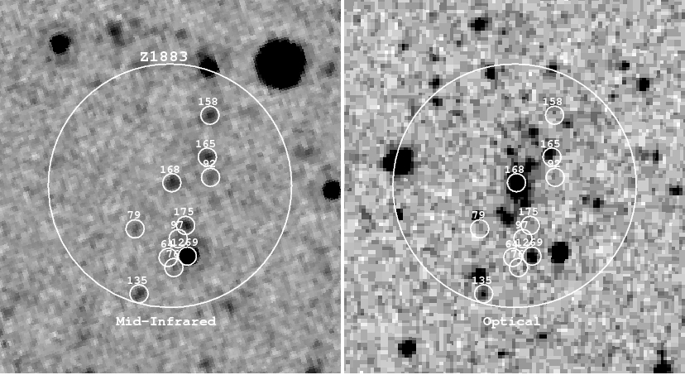
Summary
4 types of distinct BCGs identified
Roughly 11% were type 1, 8% were type 2, 44% were type 3, and 37% were type 4
20 possible candidates for cluster cooling flows found
Z1883 with Accompanying Preliminary Spectra
Example of Star Formation

Slide 11
Significance
If cluster cooling flows do exist, they are thought simulate the processes involved in early galaxy formation
Hence, their wide-scale identification and analysis could bring us one step closer towards understanding galaxy formation

Slide 12
Thank You
With special thanks again to:
Dr. Eiichi Egami of Steward Observatory
and
Dr. Linhua Jiang of Steward Observatory
April 17th, 2010

